Slide 2
OnePlusOne – evidence to innovation

Slide 4
Why relationships matter

Slide 9
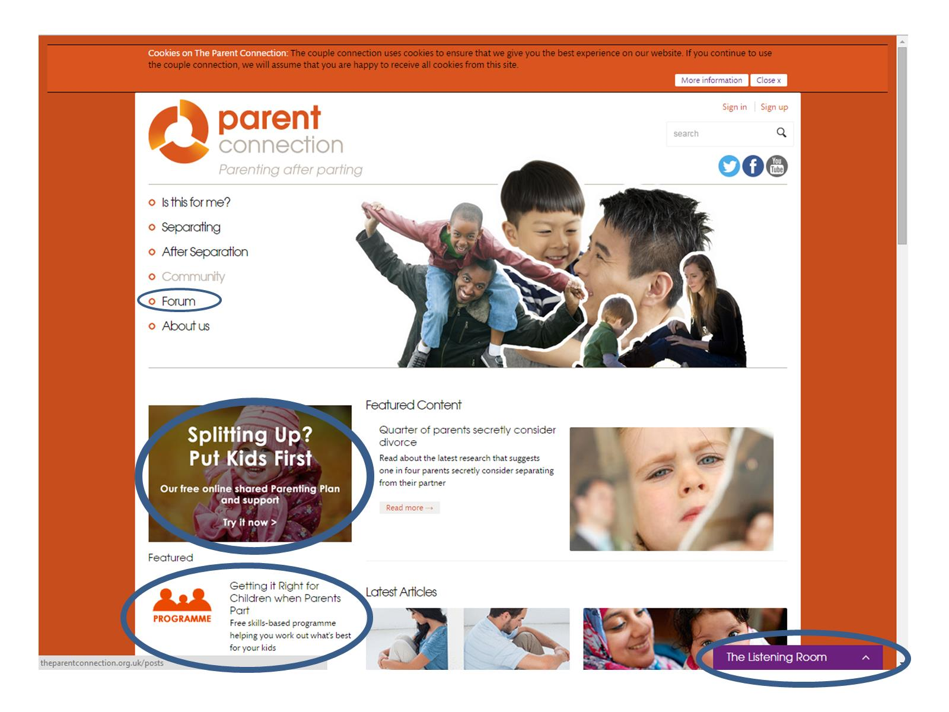

Slide 10
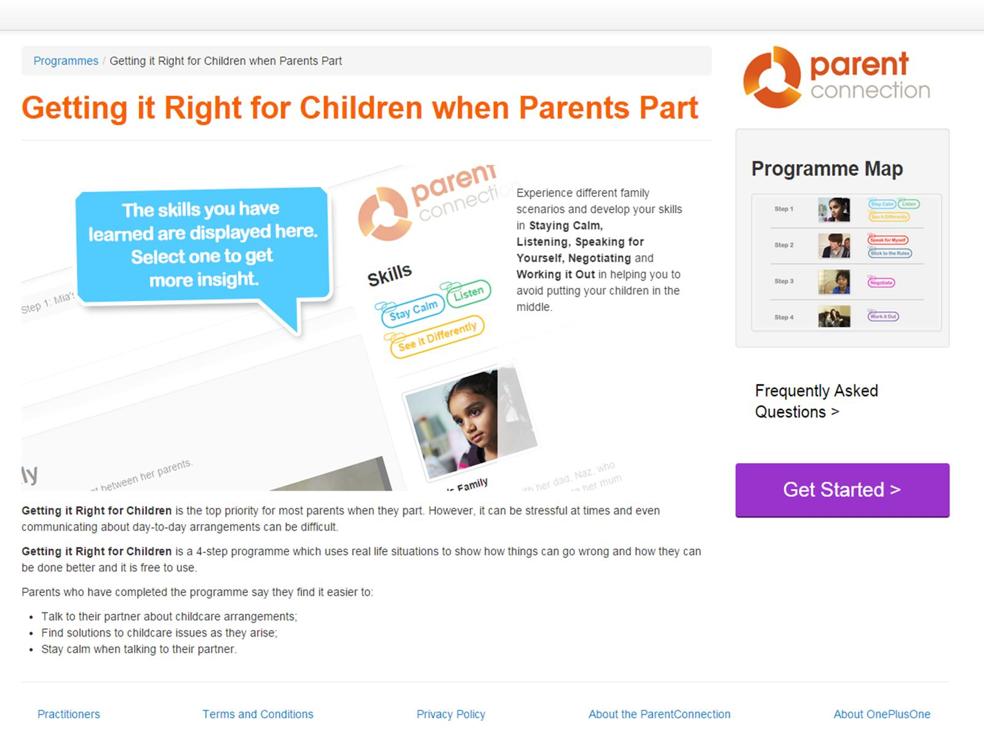

Slide 14
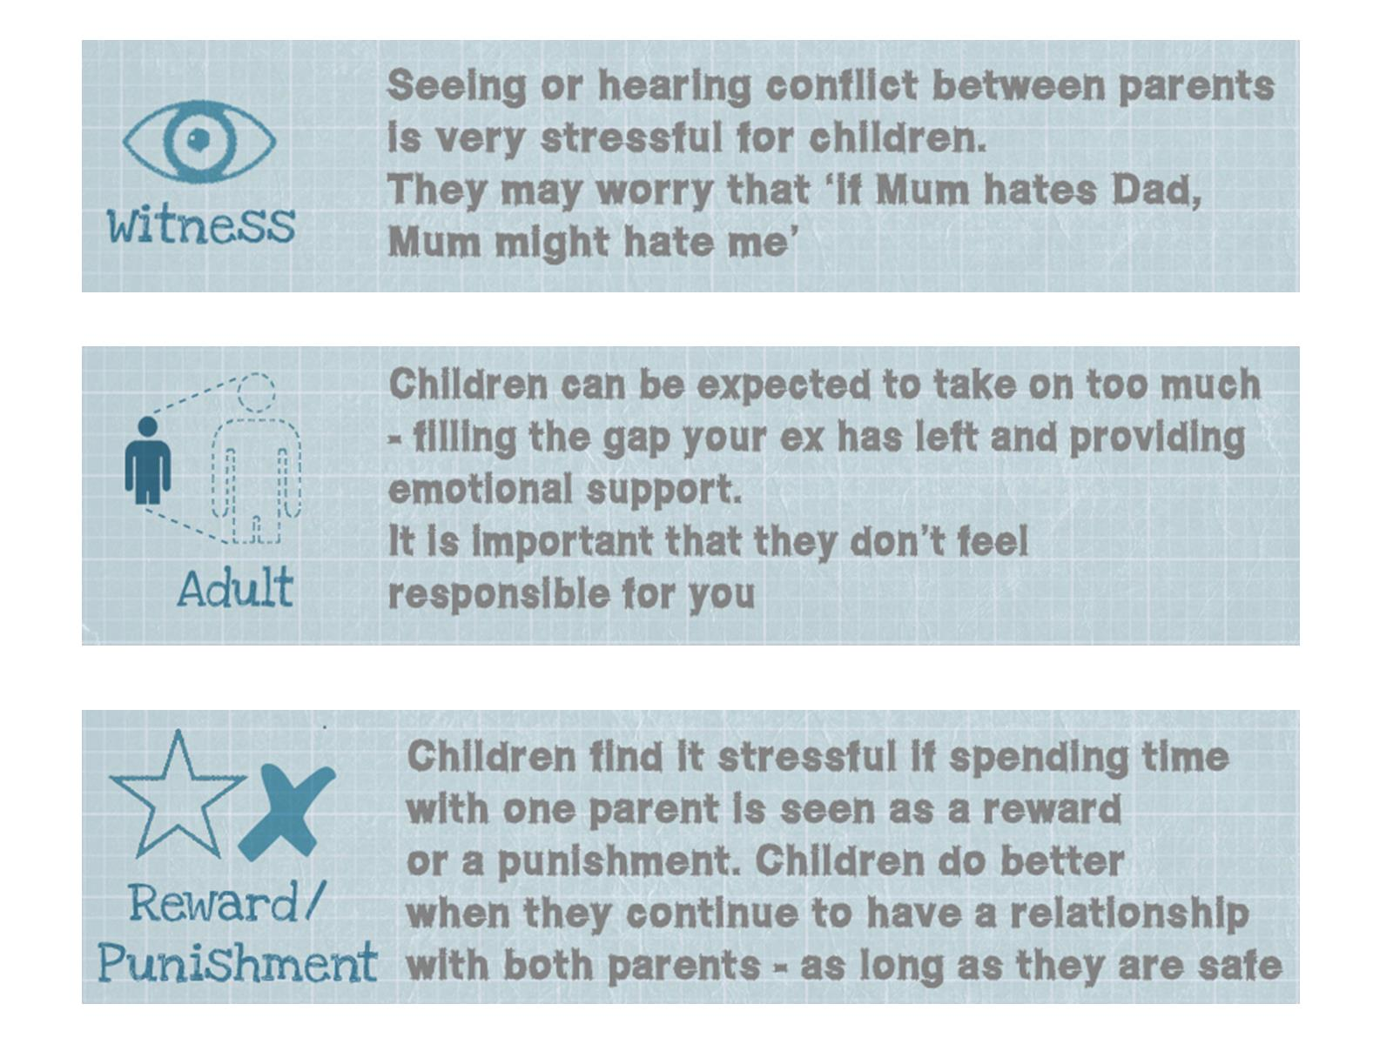

Slide 24
Splitting Up Put Kids First Part of the DWP Innovation Fund projects April 2014- September 2015

Slide 25
Emotional readiness tool

Slide 26
Importance of evidence based design and continuous evaluation for successful innovation

